Slide 1
Classifying Pneumonia in Chest X-Rays of COVID-19 Patients
By Andrew Avola, Kristen Cocciante, Amit Deb,
and Joseph Henderson

Slide 2


Our Project
We have developed a model with a 92% accuracy with the purpose of assisting doctors in identifying pneumonia is the lungs of patients with COVID-19
Through preprocessing, the inputted images are resized, eliminating unnecessary detail. This allows the model to more accurately classify abnormal levels of opacity which may indicate pneumonia

Slide 3
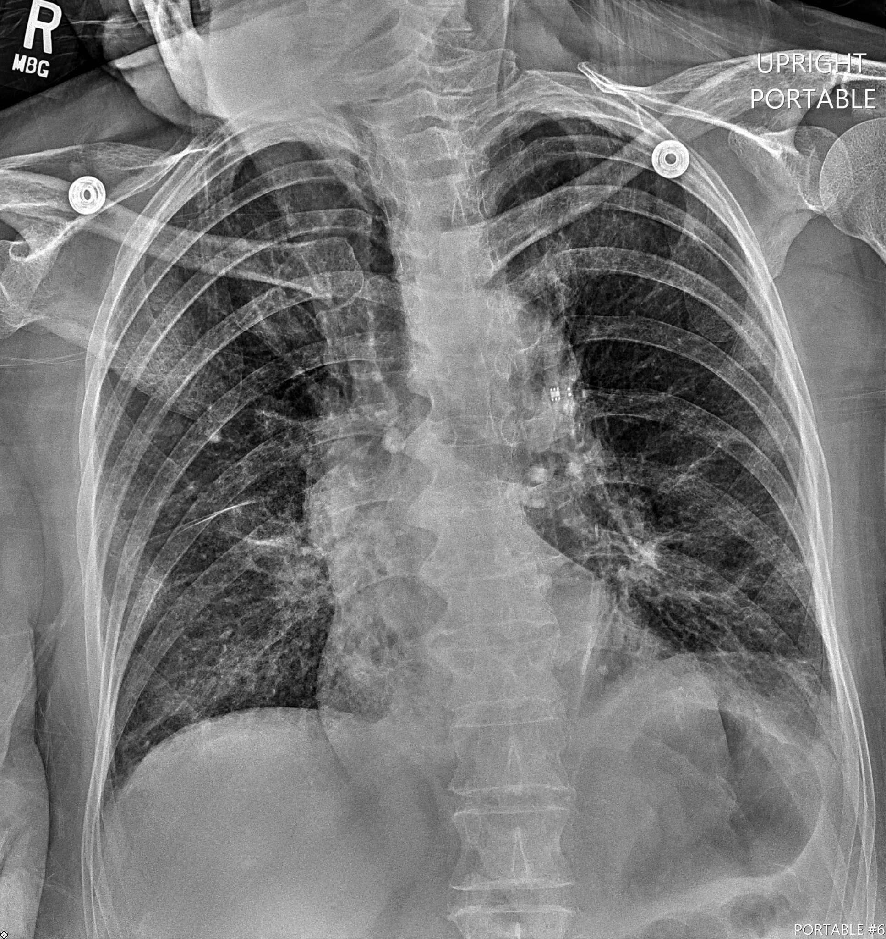
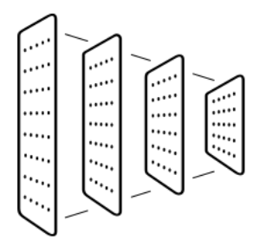
Our goal
Balance out the data in order to develop a suitable training set and avoid patient bias and data imbalance
Develop a model which accurately classifies the chest X-Rays of COVID-19 patients into one of four categories of pneumonia
Input: Images of Chest X-rays
CNN: InceptionV3, plus our own set of layers
Categories
Typical
Atypical
Indeterminate
Negative

Slide 4
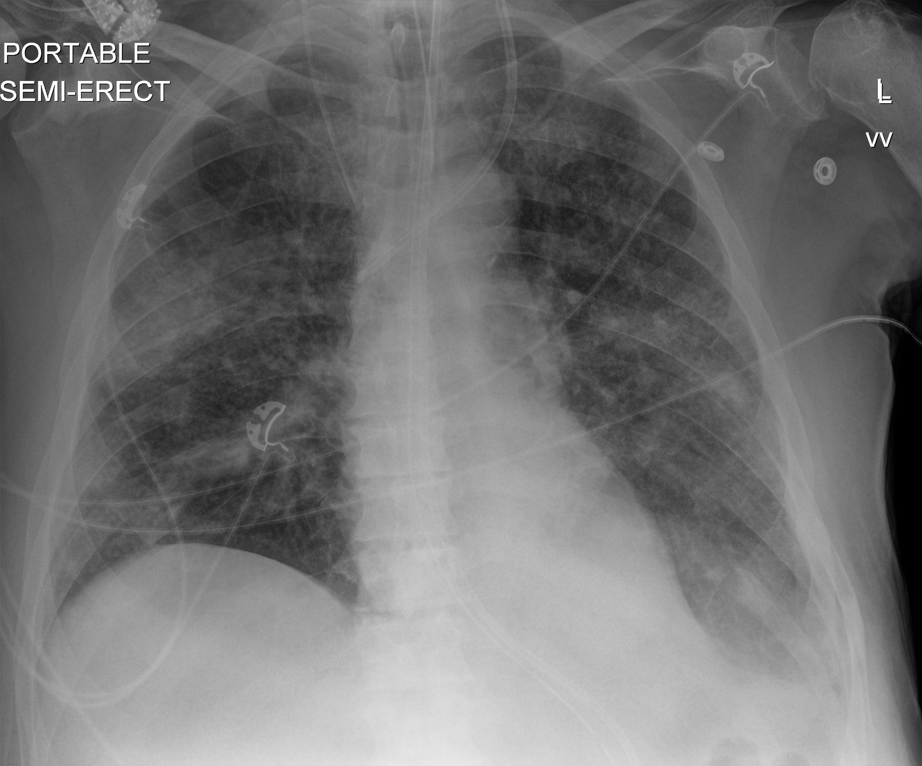
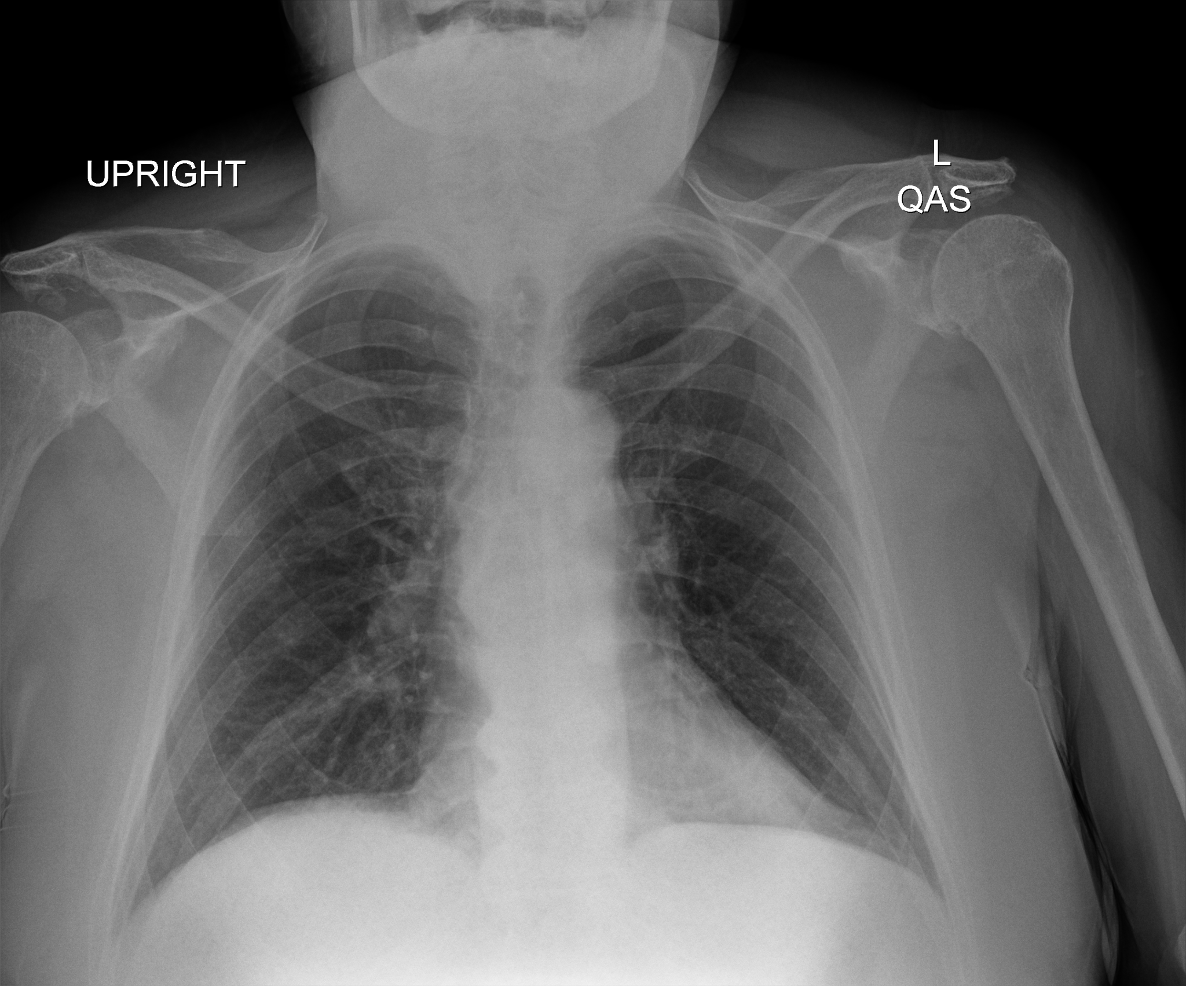
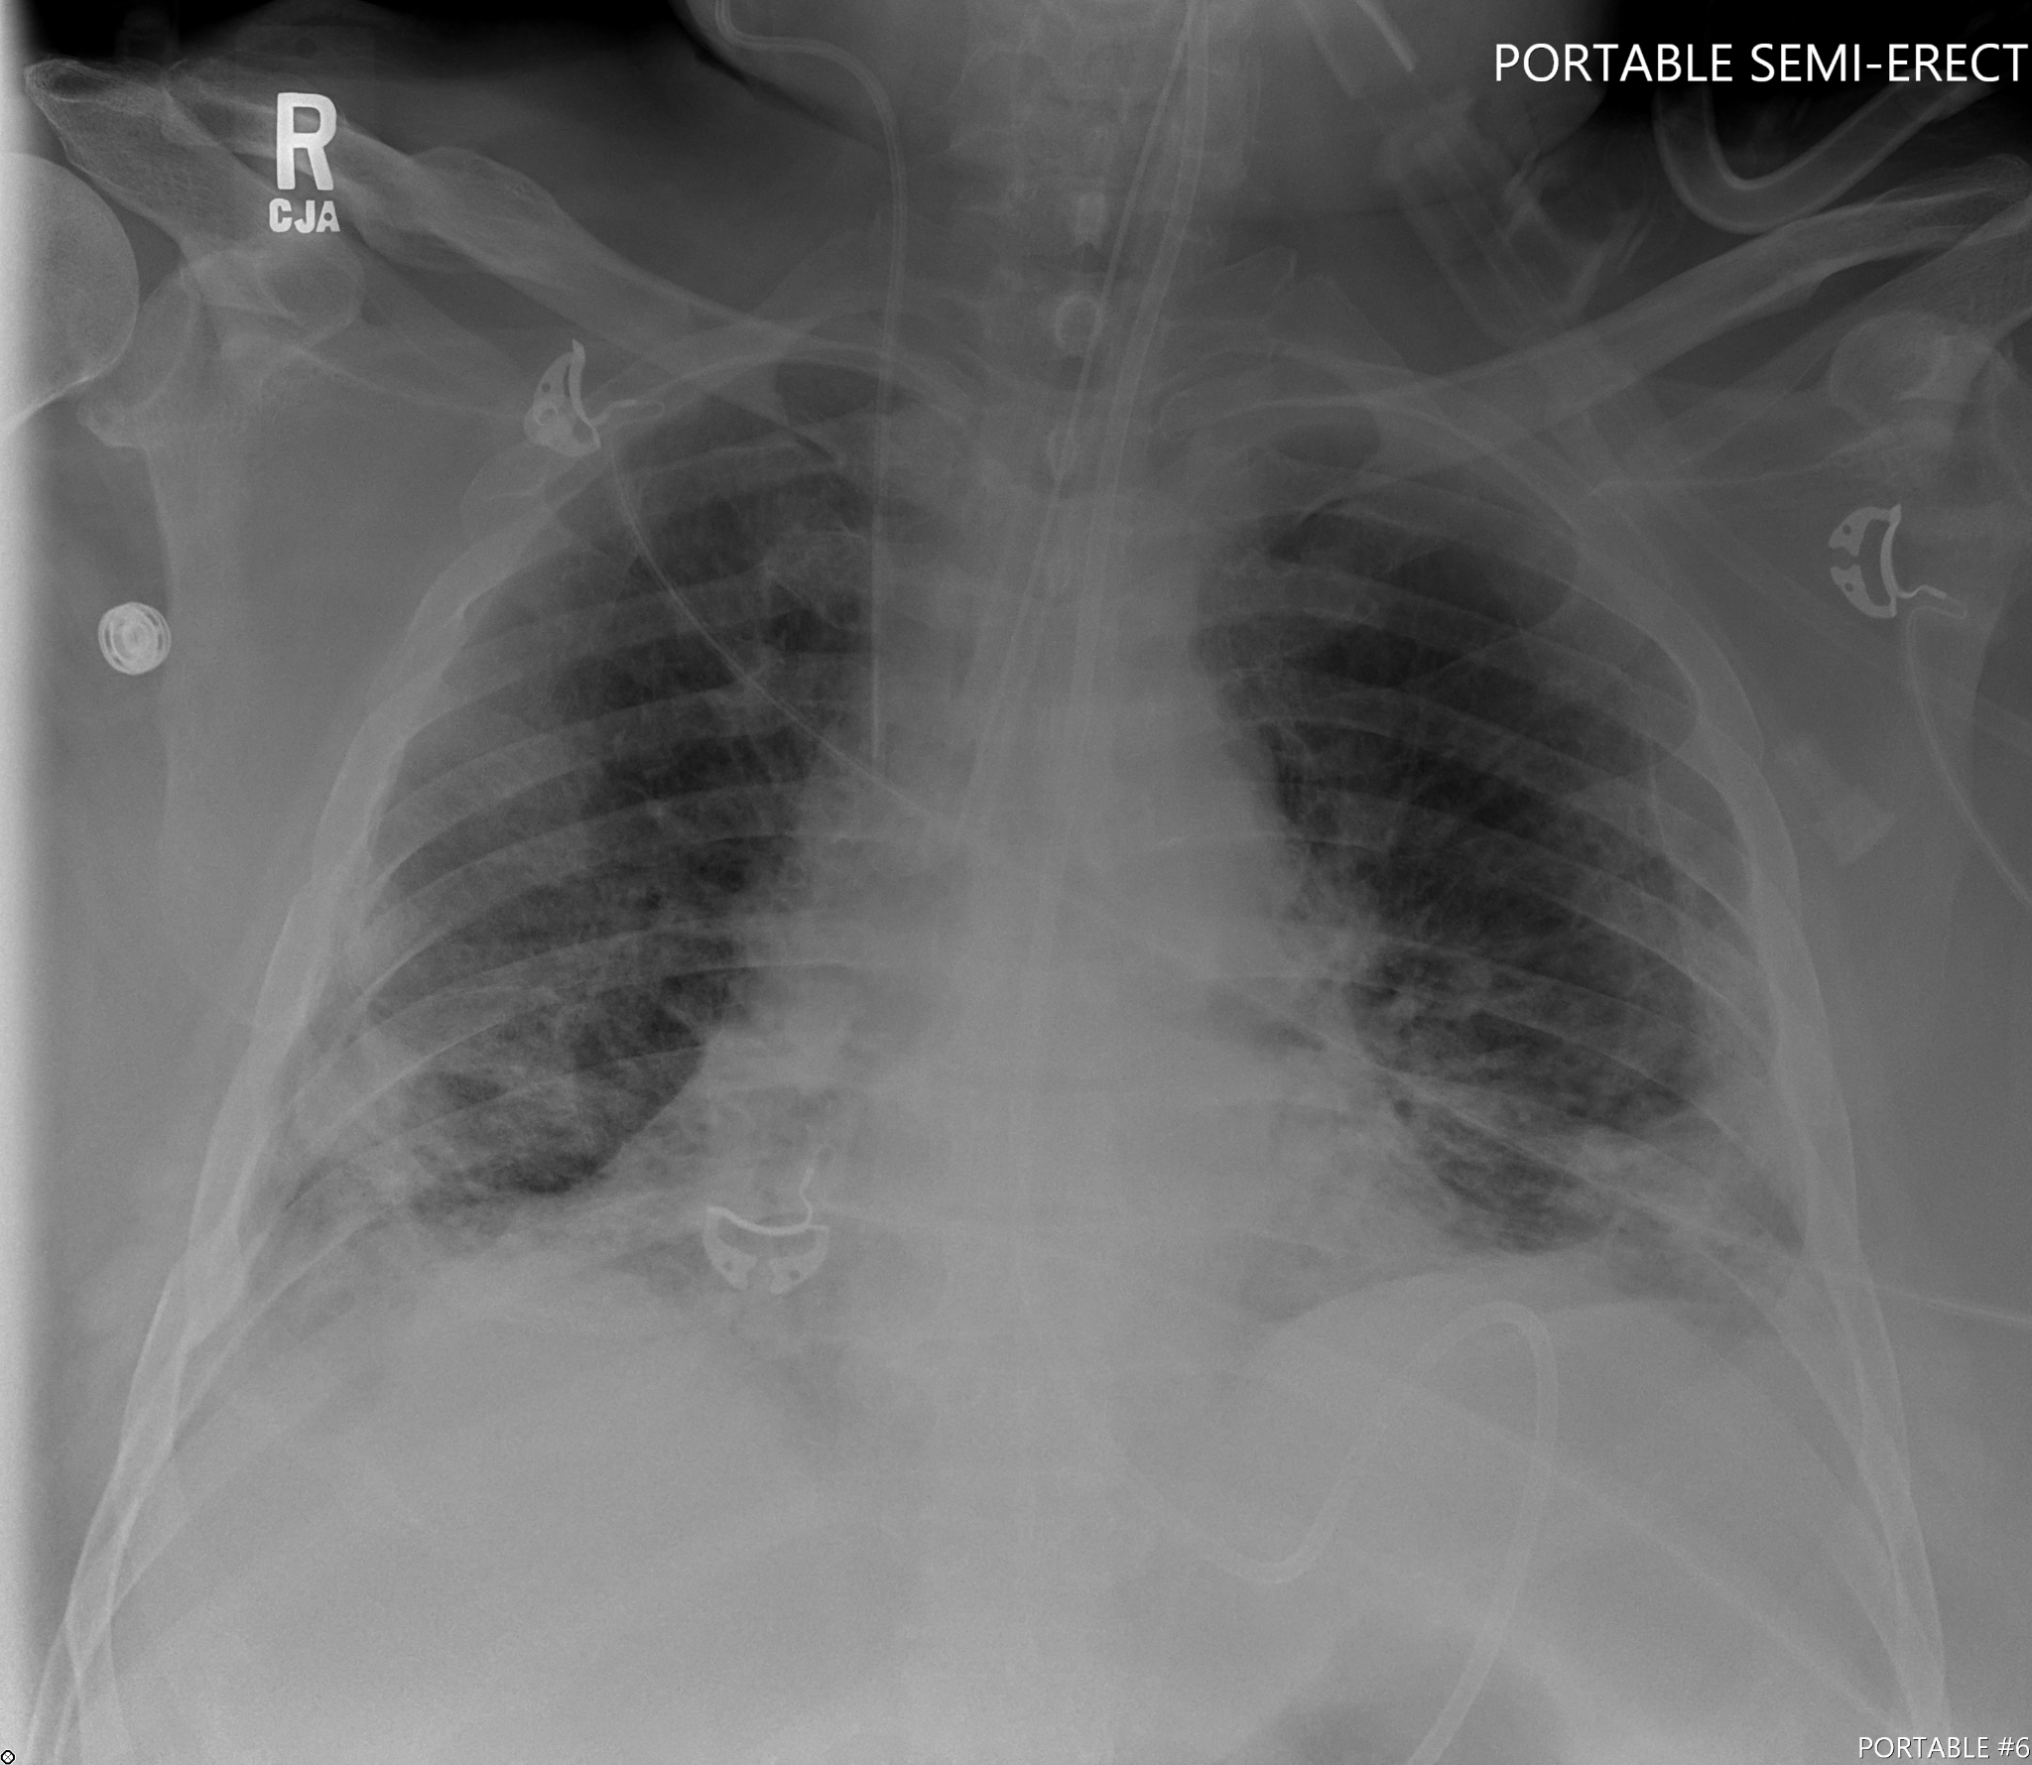
Data Categories
Typical: lungs containing the typical signs for pneumonia, which are certain levels of opacity in certain lobes of the lungs
Atypical: lungs containing other abnormalities other than the typical signs for pneumonia, e.g. pulmonary edema, lobar consolidation, etc
Indeterminate: lungs which do not contain the typical signs for pneumonia but do contain certain opacities indicative of airspace disease
Negative: lungs which do not contain pneumonia

Slide 5
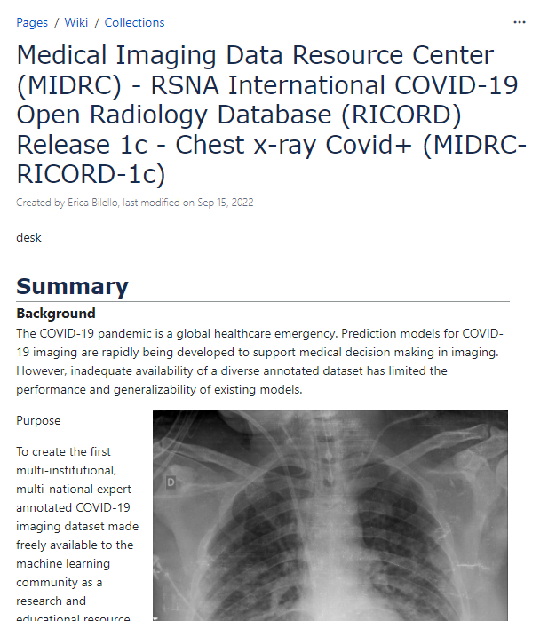
Data Source: MIDRC-RICORD Radiology Database
Data sourced from Cancer Imaging Archive
Released in an anonymized form
Maintains patient confidentiality
Only information we have access to is the patient’s gender and age at the time of the scan
Details:
Name - Residence -
Age - 59 Gender - Male

Slide 6
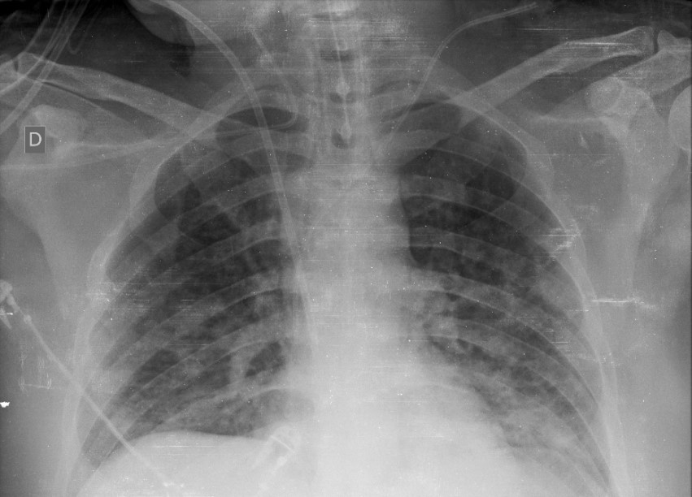
Parsing through Anonymized Data
Dataset
Two accompanying data files
Clinical data file which associates scans with a category
Annotations file which associates scans with a given patient
The file names of scans create correspondences between the scan and the files, allowing us to cross reference the scan between each file
Clinical Data
Annotations
Scan is sourced from dataset.
Scan is looked up in the CD file and assigned a category.
Scan is cross compared with the annotations and associated with a patient.

Slide 7

The Memorization Problem: Initial Approach
Initial approach was to pool scans and associate them with their labels before the 75/25 split, disregarding their associations with the patient
This caused the same patient’s scan to appear in both the train and test set
Causes the model to MEMORIZE the appearance of the patient instead of meaningfully recognizing features
Train
Test
Here the same patient’s scans are split across both the train and test sets. This will cause the model to simply memorize the patient’s appearance.

Slide 8
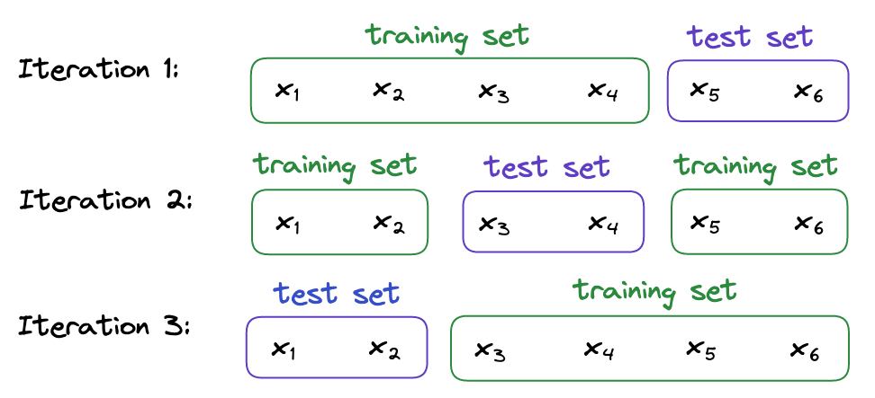
The Memorization Problem: Leave-Several-Out
To ensure that our model does not memorize patients, a more delicate split is required
Grouping the scans by patient and then perform our train/test split
This ensures that no patient will have scans in both the train and test set
We can perform this splitting process multiple times and train our model on a different split each iteration

Slide 9
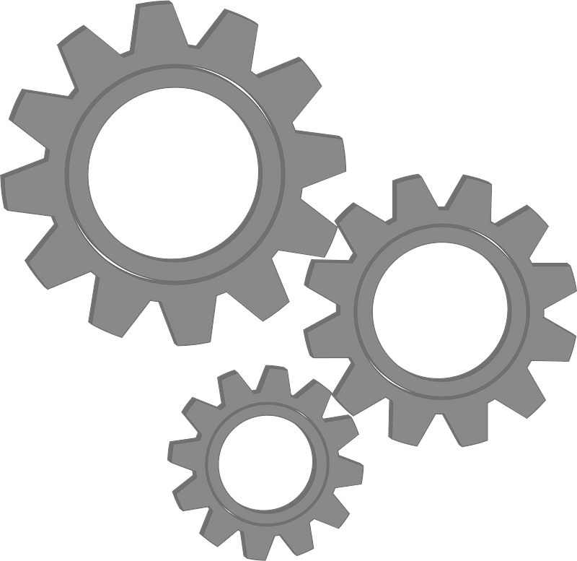
The Memorization Problem: Splitting Across Patients
Dataset
Splitting script generates a 75/25 split of patients
Ensures variability - each split is different
10 splits are created and then utilized in the training process via the Leave-k-out technique
Splitting script
x10

Slide 10
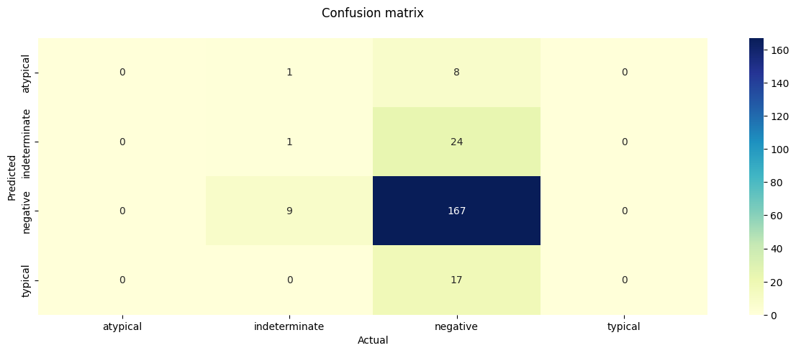
Data Imbalance: The Problem
Another issue we encountered with the data
Very high imbalance of negative scans compared to other 3 categories
Without addressing this imbalance, the model was more likely to falsely predict a scan as negative
An overabundance of negative scans in the initial dataset led to our model predicting almost all scans as negative. The model associated with the above matrix had an accuracy of about 75%, but only because nearly ¾ of the scans in the data set are negative and so the accuracy value was not high, but just a byproduct of the guessing patterns of the model.

Slide 11
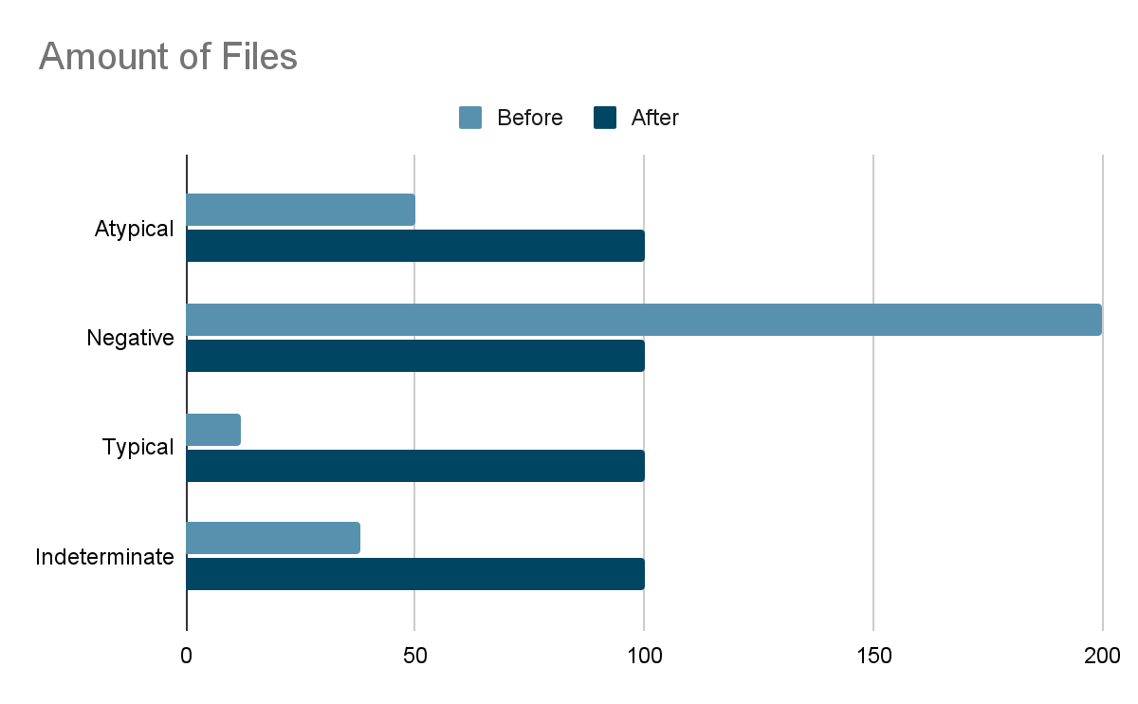
Data Imbalance: The Goal
We have to decide how to normalize the amount of data given to us.
Double files in the smallest category
Make the other categories file amount to the doubled smallest category amount
Example of what might happen to each batch of images after the data imbalance is corrected

Slide 12
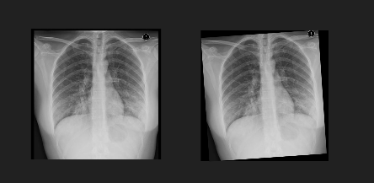
Data Imbalance: Filling
In order to fill the categories to match the amount of files to the doubled category we need to fill.
There are two ideas to fill data:
Clone a file in a category until we reach the normalized amount
We run into the issue of having bias because we would train on double the amount of the same images
Clone and augment the file in until we reach the normalized amount
We do augmentation by rotating the image slightly by -4 to 4 degrees to simulate a doctor perhaps scanning in a xray slight off or a patient not being centered

Slide 13
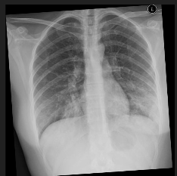
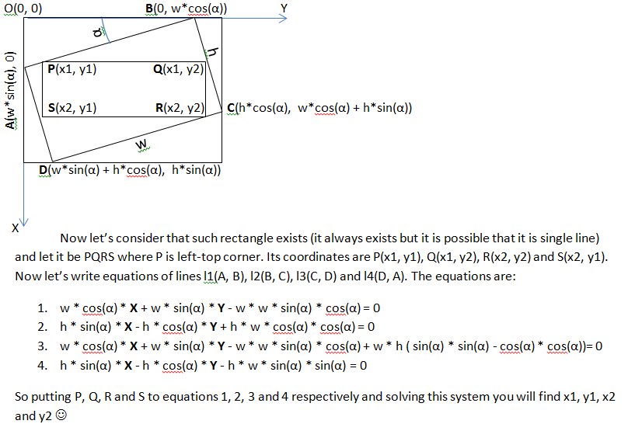
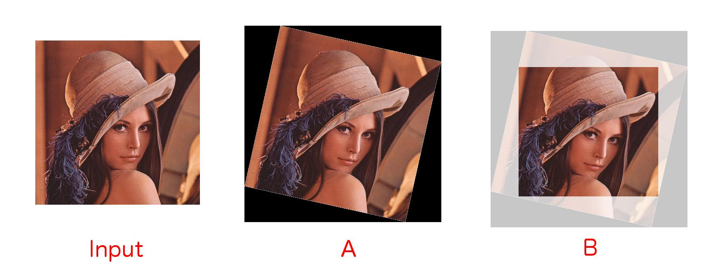
Data Imbalance: Remove Margins From Rotated Images
In order to remove these margins for the rotated image
We need perform some several operations to achieve this result, including calculating the bounds and scaling the result to achieve the max area of the image^{[1][2]}

Slide 14
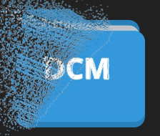


Data Imbalance: Culling
The categories we cull are categories whose file amounts are greater than the normalized amount. We randomly cull files in those categories until we reach the normalized amount. This is so that we don't have so much bias in our training set.

Slide 15
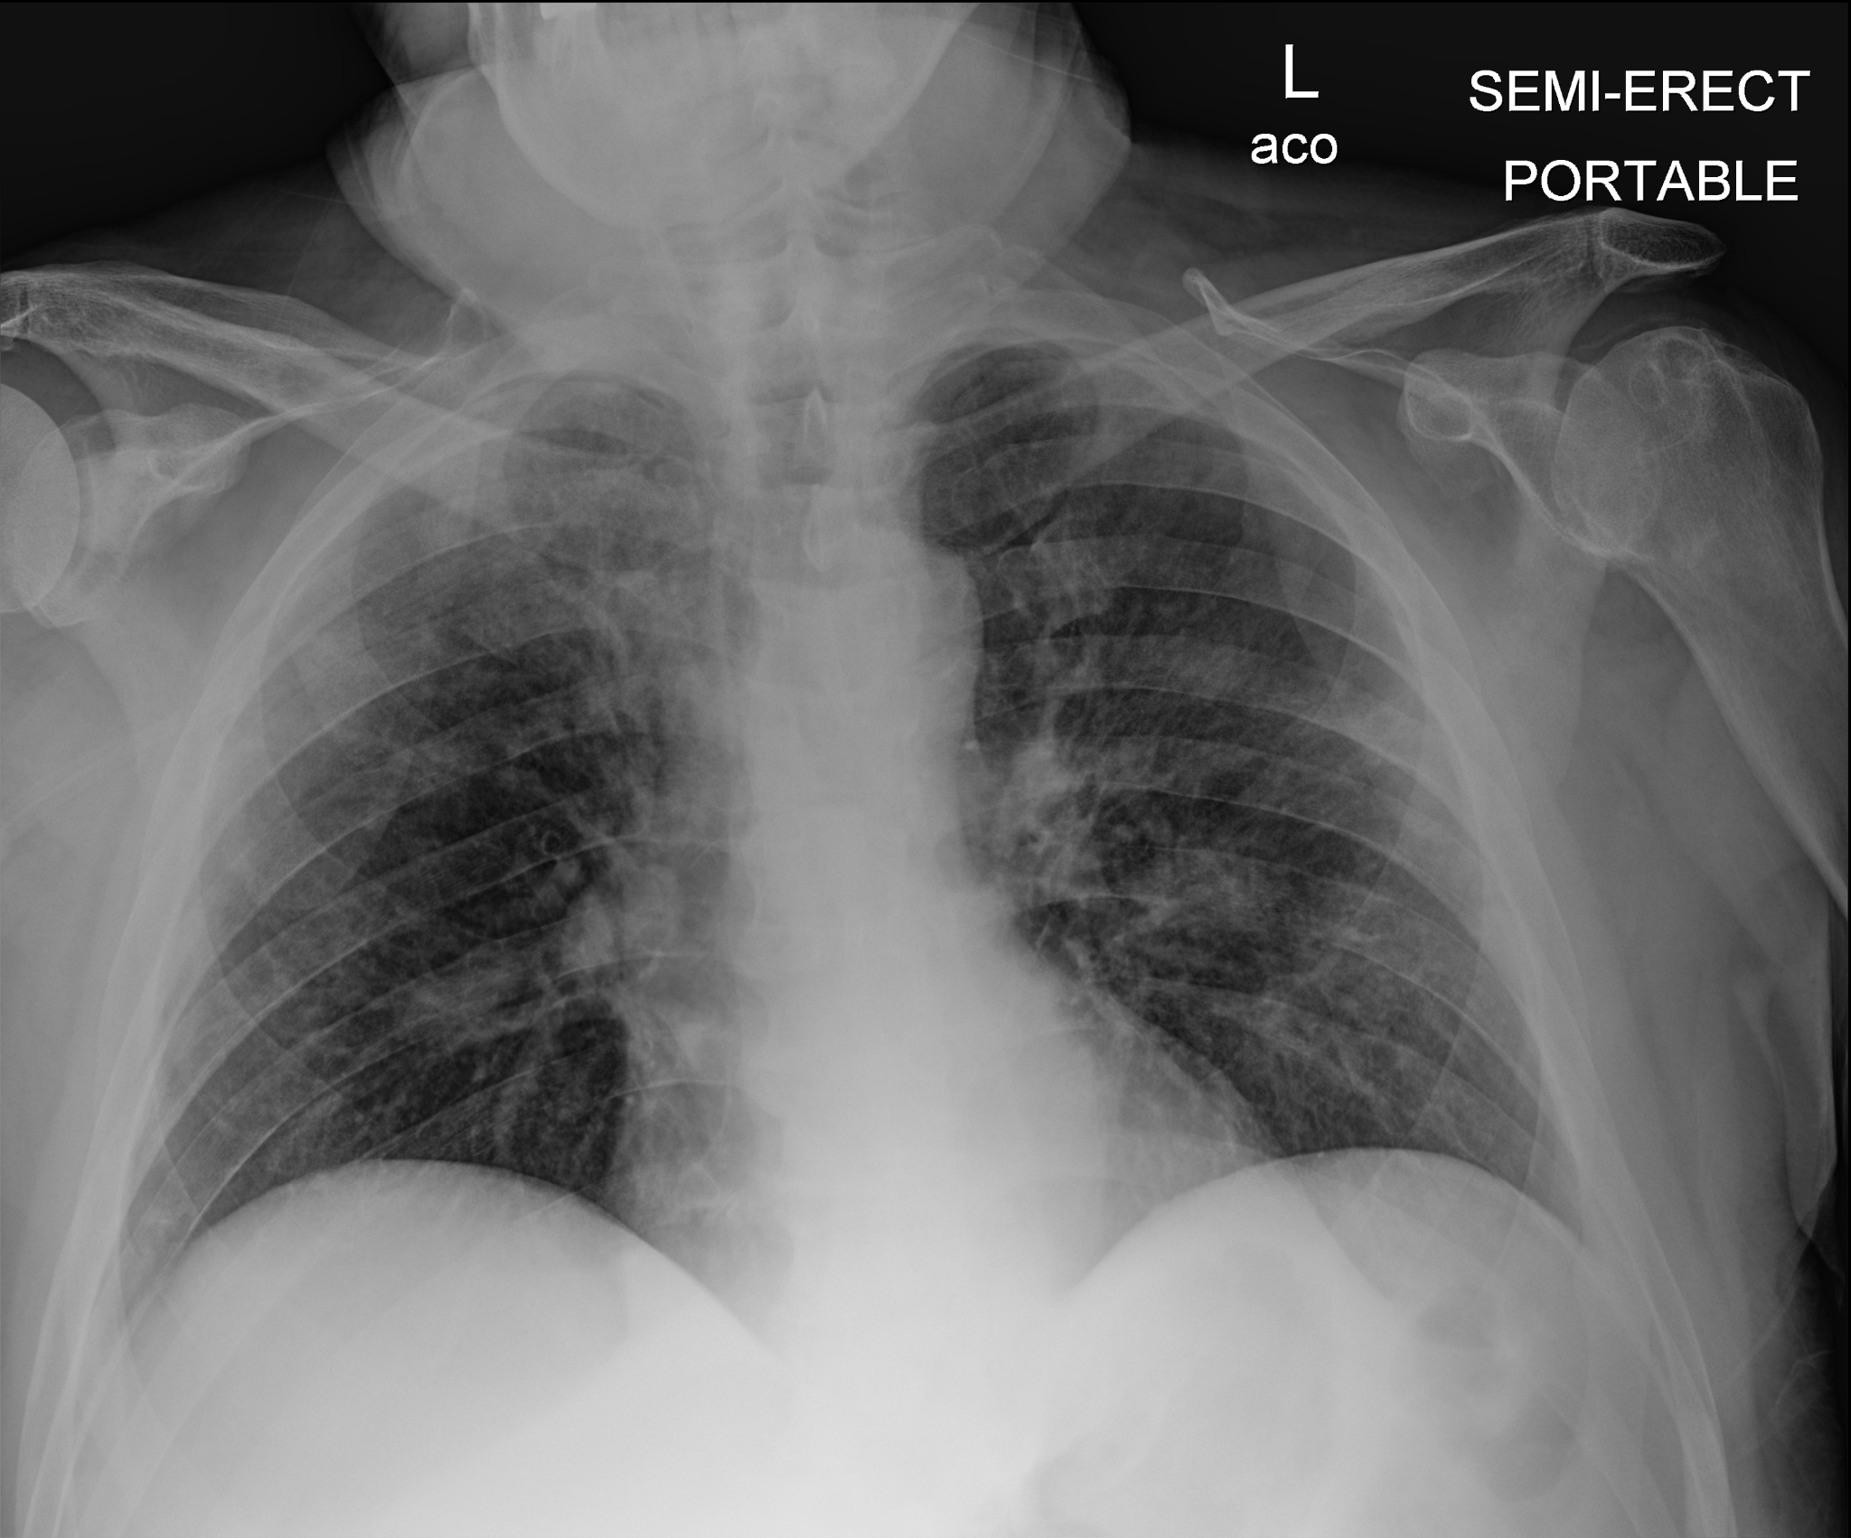
Pre-Preprocessing the Data for the Model
We need to make sure these images are ready for the model to accept
Images need to be unsigned integer 8 bit values
Images need to have pixel values between 0 - 255
Images need have a color channel
Images need to be 299 pixels by 299 pixels

Slide 16
Efficiency of Loading Images
Loading through this script takes about a hour to complete. There are two ways to run it:
With the model script
The problem with this script is that if the model needs to be adjusted, we would need to run the whole script again.
Loading the images into a np files
The images will be converted to a np array then appended to another np array then saved to a np file. This process will take an hour to complete
The model can load the file in less than a second. Thus having a very elegant way to have the images loaded in very fast.

Slide 17
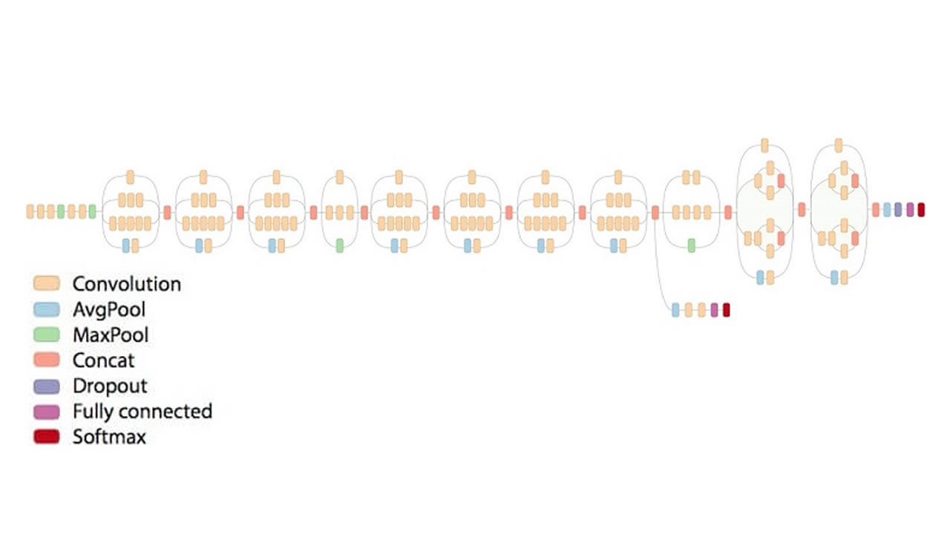
Transfer Learning
Initial thoughts were to find a pre-trained transfer learning model for image classification
We chose InceptionV3 which has attained greater than 78.1% accuracy in 170 epochs

Slide 18
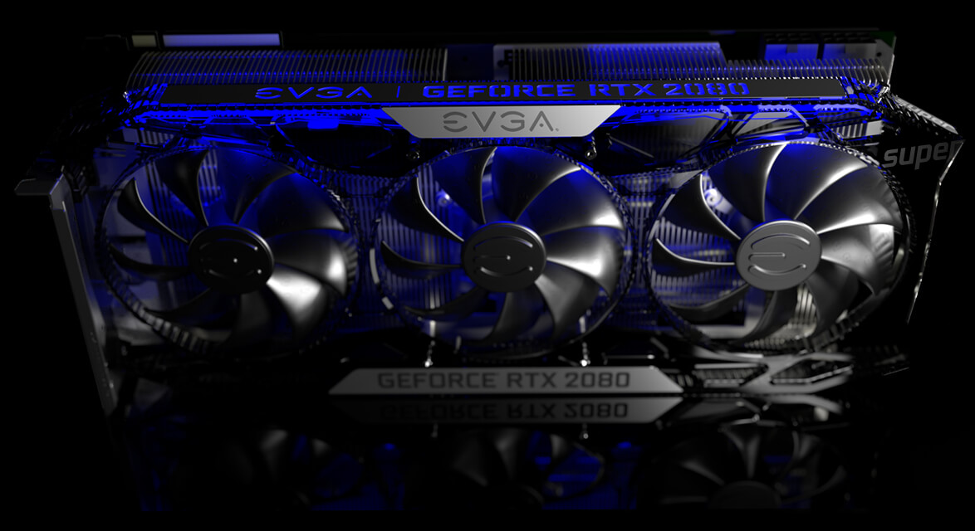
GPU Compatibility
Tensorflow has the ability to allow GPU compatibility for high intensity computations
We installed Tensorflow GPU and downloaded proper drivers for our Tensorflow version
Computation speed increased from 3 minute epochs to 4 second epochs with a RTX 2080 Super

Slide 19
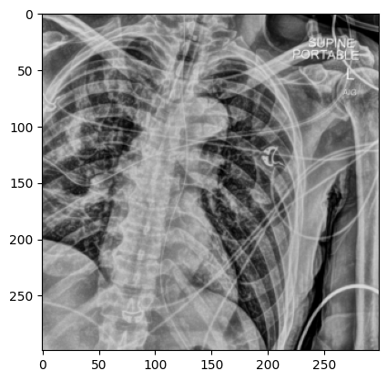
Obtain Proper Splits of Data
Needed 10 splits of training and testing data
Data needed to be 299x299 pixels for the InceptionV3 pre-processing pipeline
1 Hour of computation time per split of data being obtained
Stored as numpy arrays to drastically speed up image loading time into Jupyter Notebook

Slide 20
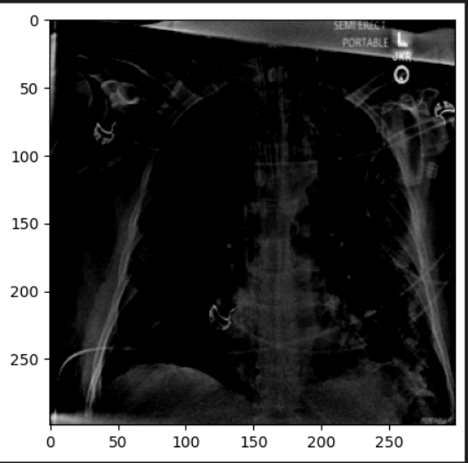
InceptionV3 Pre-processing
Using InceptionV3’s pre-processing functions will allow us to make sure that the images in our arrays are all of the same size
Model pre-processing may shorten model training time and also speed up model inference

Slide 21
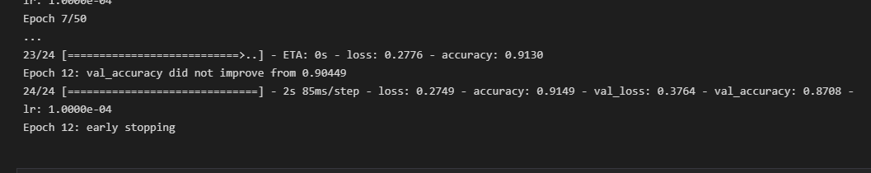
First Run-through
Passing our first set of data through the model before any obtained weights gave us around 50% validation accuracy
After all 10 data sets we obtained around 88% validation accuracy

Slide 22
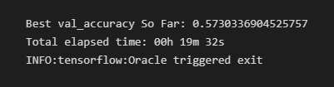
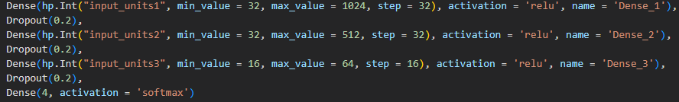
Keras Tuner
We used Keras Tuner to test our model for optimization, looking for our highest validation accuracy
Keras Tuner allowed us to find different hyper parameters in a specified range for the units in our dense layers
On our first of 10 sets of data, we obtained a validation accuracy of ~57%

Slide 23
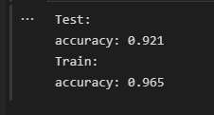
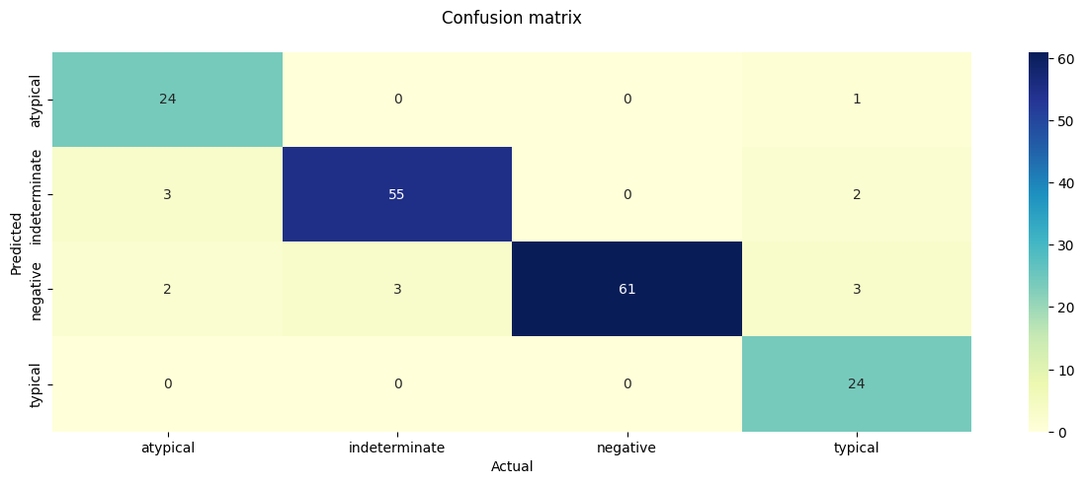
Final Run-through After Optimization
After Keras Tuner optimizations, we ran all 10 sets of data through the model again for re-training
Obtained 92% test accuracy and 96.5% training accuracy

Slide 24
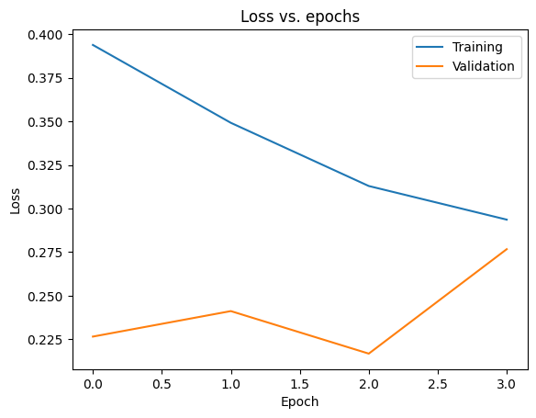
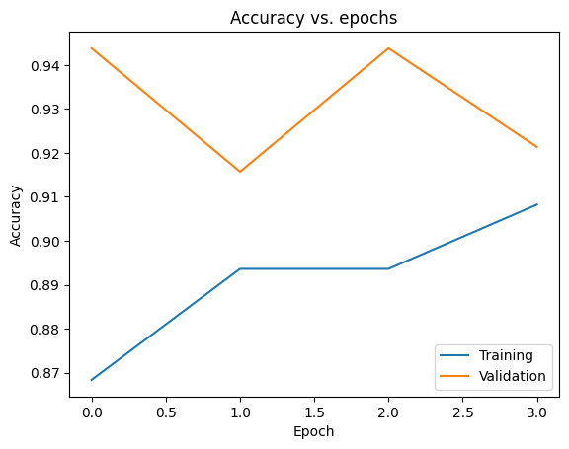
Graphs After Optimization

Slide 25
Sources
Cancer Imaging Archive COVID Pneumonia Dataset K-Fold Cross Validation
Math Behind Rotating Images and Getting Max Area
Rotating Images and Getting Max Area

